Slide 1
Residential Wall
Architecture

Slide 2
The Project
Draw two (2) ¾” scale walls and join them together
One (1) wall will have a window centered
One (1) wall will have a door centered
A floor plan will be drawn and we will build to certain building codes

Slide 3
Terms

Slide 4
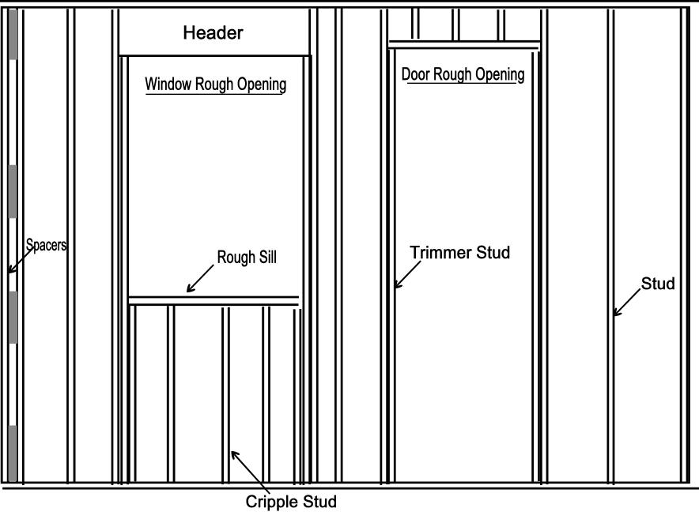
Cripple Stud
A short piece of stud used to transfer a load from a top plate to a header or from a sill to a sole plate.

Slide 5
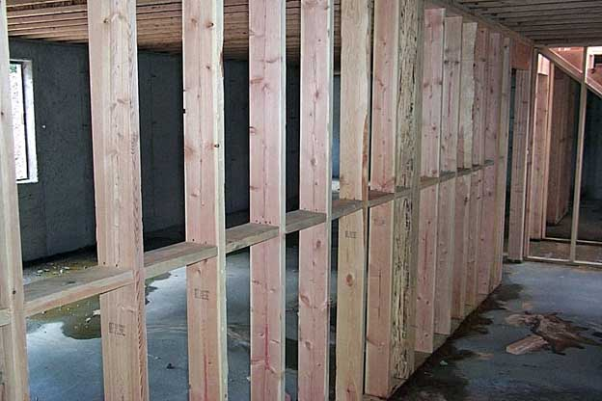
Fire blocks
Horizontal boards nailed in between the vertical studs to help prevent fire from moving up through the inside of a wall.

Slide 6
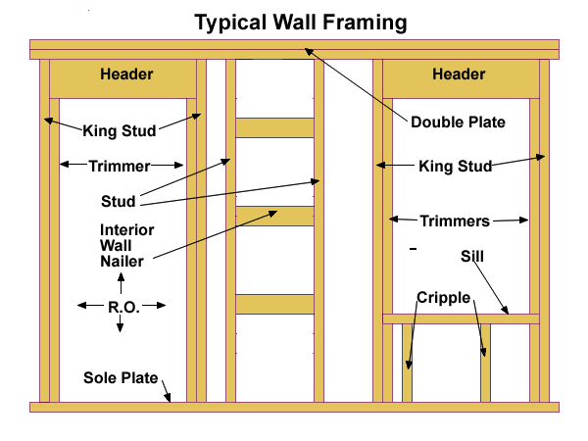
header
A doubled 2x6 or 2x8 that is held up by trimmer boards. Used to transfer the weight of the wall around an opening down to the sole plate

Slide 7
Rough Opening (RO)
Take the finished opening of the door or window and add 2 inches to the total measurement

Slide 8
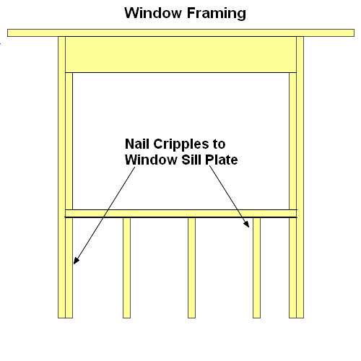
Sill
The horizontal board below the opening of a window

Slide 9
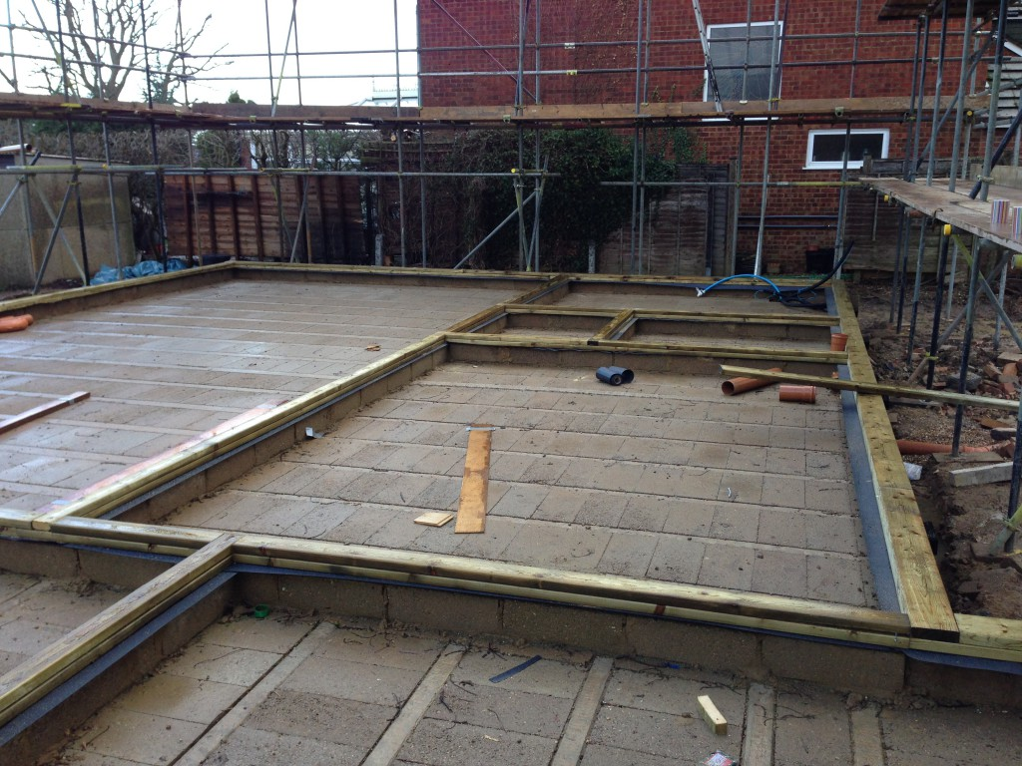
Sole plate
A 2x4 that forms the base of the wall, and lies horizontal on the floor. Vertical studs are nailed to the sole and top plates.

Slide 10
Designing the walls

